Slide 1
Week 13_Lec1
ARP and VLANs

Slide 2

ARP: address resolution protocol
Question: how to determine interface’s MAC address, knowing its IP address?
ARP table: each IP node (host, router) on LAN has table
ARP
137.196.7.78
IP/MAC address mappings for some LAN nodes:
< IP address; MAC address; TTL>
TTL (Time To Live): time after which address mapping will be forgotten (typically 20 min)
1A-2F-BB-76-09-AD
ARP
ARP
LAN
71-65-F7-2B-08-53
58-23-D7-FA-20-B0
137.196.7.23
137.196.7.14
ARP
0C-C4-11-6F-E3-98
137.196.7.88

Slide 3
ARP protocol in action
example: A wants to send datagram to B
B’s MAC address not in A’s ARP table, so A uses ARP to find B’s MAC address
A broadcasts ARP query, containing B's IP addr
destination MAC address = FF-FF-FF-FF-FF-FF
all nodes on LAN receive ARP query
1
Ethernet frame (sent to FF-FF-FF-FF-FF-FF)
C
Source MAC: 71-65-F7-2B-08-53
Source IP: 137.196.7.23
Target IP address: 137.196.7.14
…
ARP table in A
IP addr
MAC addr
TTL
TTL
A
B
1
71-65-F7-2B-08-53
58-23-D7-FA-20-B0
137.196.7.23
137.196.7.14
D

Slide 4
ARP protocol in action
example: A wants to send datagram to B
B’s MAC address not in A’s ARP table, so A uses ARP to find B’s MAC address
ARP message into Ethernet frame (sent to 71-65-F7-2B-08-53)
C
Target IP address: 137.196.7.14
Target MAC address:
58-23-D7-FA-20-B0
…
ARP table in A
IP addr
MAC addr
TTL
TTL
A
B
2
71-65-F7-2B-08-53
58-23-D7-FA-20-B0
137.196.7.23
137.196.7.14
2
B replies to A with ARP response, giving its MAC address
D

Slide 5
ARP protocol in action
example: A wants to send datagram to B
B’s MAC address not in A’s ARP table, so A uses ARP to find B’s MAC address
C
ARP table in A
IP addr
MAC addr
TTL
TTL
A
B
137.196.
7.14
58-23-D7-FA-20-B0
500
71-65-F7-2B-08-53
58-23-D7-FA-20-B0
137.196.7.23
137.196.7.14
3
A receives B’s reply, adds B entry into its local ARP table
D

Slide 6

Routing to another subnet: addressing
walkthrough: sending a datagram from A to B via R
focus on addressing – at IP (datagram) and MAC layer (frame) levels
assume that:
A knows B’s IP address
A knows IP address of first hop router, R (how?)
A knows R’s MAC address (how?)
A
R
B
111.111.111.111
74-29-9C-E8-FF-55
222.222.222.222
49-BD-D2-C7-56-2A
222.222.222.220
1A-23-F9-CD-06-9B
111.111.111.112
111.111.111.110
CC-49-DE-D0-AB-7D
E6-E9-00-17-BB-4B
222.222.222.221
88-B2-2F-54-1A-0F

Slide 7
Routing to another subnet: addressing
A creates IP datagram with IP source A, destination B
A creates link-layer frame containing A-to-B IP datagram
R's MAC address is frame’s destination
MAC src: 74-29-9C-E8-FF-55
MAC dest: E6-E9-00-17-BB-4B
IP
Eth
Phy
IP src: 111.111.111.111
IP dest: 222.222.222.222
A
R
B
111.111.111.111
74-29-9C-E8-FF-55
222.222.222.222
49-BD-D2-C7-56-2A
222.222.222.220
1A-23-F9-CD-06-9B
111.111.111.112
111.111.111.110
CC-49-DE-D0-AB-7D
E6-E9-00-17-BB-4B
222.222.222.221
88-B2-2F-54-1A-0F

Slide 8
Routing to another subnet: addressing
frame sent from A to R
frame received at R, datagram removed, passed up to IP
MAC src: 74-29-9C-E8-FF-55
MAC dest: E6-E9-00-17-BB-4B
IP src: 111.111.111.111
IP dest: 222.222.222.222
IP
Eth
Phy
IP src: 111.111.111.111
IP dest: 222.222.222.222
IP
Eth
Phy
A
R
B
111.111.111.111
74-29-9C-E8-FF-55
222.222.222.222
49-BD-D2-C7-56-2A
222.222.222.220
1A-23-F9-CD-06-9B
111.111.111.112
111.111.111.110
CC-49-DE-D0-AB-7D
E6-E9-00-17-BB-4B
222.222.222.221
88-B2-2F-54-1A-0F

Slide 9
Routing to another subnet: addressing
R determines outgoing interface, passes datagram with IP source A, destination B to link layer
R creates link-layer frame containing A-to-B IP datagram. Frame destination address: B's MAC address
MAC src: 1A-23-F9-CD-06-9B
MAC dest: 49-BD-D2-C7-56-2A
IP
Eth
Phy
IP src: 111.111.111.111
IP dest: 222.222.222.222
A
R
B
111.111.111.111
74-29-9C-E8-FF-55
222.222.222.222
49-BD-D2-C7-56-2A
222.222.222.220
1A-23-F9-CD-06-9B
111.111.111.112
111.111.111.110
CC-49-DE-D0-AB-7D
E6-E9-00-17-BB-4B
222.222.222.221
88-B2-2F-54-1A-0F

Slide 10
Routing to another subnet: addressing
R determines outgoing interface, passes datagram with IP source A, destination B to link layer
R creates link-layer frame containing A-to-B IP datagram. Frame destination address: B's MAC address
MAC src: 1A-23-F9-CD-06-9B
MAC dest: 49-BD-D2-C7-56-2A
transmits link-layer frame
IP
Eth
Phy
IP
Eth
Phy
IP src: 111.111.111.111
IP dest: 222.222.222.222
A
R
B
111.111.111.111
74-29-9C-E8-FF-55
222.222.222.222
49-BD-D2-C7-56-2A
222.222.222.220
1A-23-F9-CD-06-9B
111.111.111.112
111.111.111.110
CC-49-DE-D0-AB-7D
E6-E9-00-17-BB-4B
222.222.222.221
88-B2-2F-54-1A-0F

Slide 11
Routing to another subnet: addressing
B receives frame, extracts IP datagram destination B
B passes datagram up protocol stack to IP
IP src: 111.111.111.111
IP dest: 222.222.222.222
IP
Eth
Phy
IP
Eth
Phy
A
R
B
111.111.111.111
74-29-9C-E8-FF-55
222.222.222.222
49-BD-D2-C7-56-2A
222.222.222.220
1A-23-F9-CD-06-9B
111.111.111.112
111.111.111.110
CC-49-DE-D0-AB-7D
E6-E9-00-17-BB-4B
222.222.222.221
88-B2-2F-54-1A-0F

Slide 12
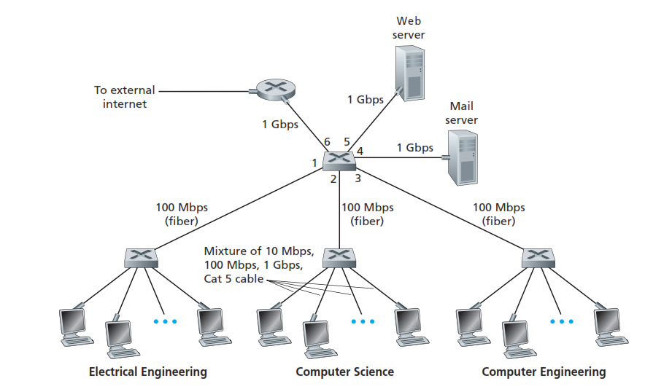
Institutional network

Slide 13

Switches vs. routers
application
transport
network
link
physical
both are store-and-forward:
routers: network-layer devices (examine network-layer headers)
switches: link-layer devices (examine link-layer headers)
both have forwarding tables:
routers: compute tables using routing algorithms, IP addresses
switches: learn forwarding table using flooding, learning, MAC addresses
datagram
frame
link
physical
frame
switch
network
link
physical
datagram
frame
application
transport
network
link
physical

Slide 14
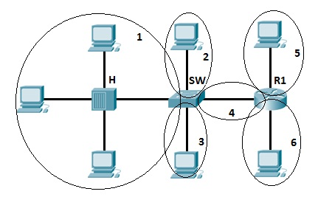
Collision Vs Broadcast domain
6 – CD
1 - BD
Data Link Layer
5-14

Slide 15
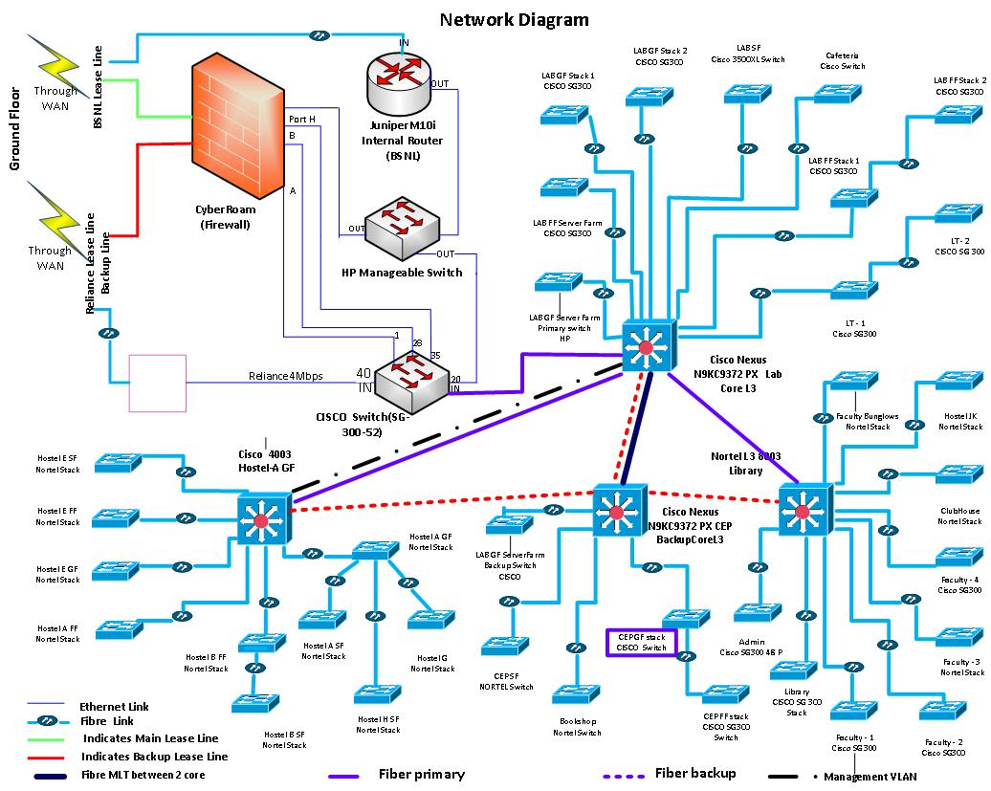
DAIICT Network topology
Institutional LANS
Configered hierarchically
Each dept (LAN)
Connected to other LANS

Slide 16
VLANs: motivation
No traffic isolation
all layer-2 broadcast traffic (ARP, DHCP, unknown location of destination MAC address) must cross entire LAN
Inefficient use of switches
Multiple departments with less users
each one switch (96 port )
Wastage of resources
Managing users
CS user moves office to EE, but wants connect to CS switch?

Slide 17
Virtual Local Area Network
A switch that allows multiple Local area networks to be defined over a single physical local area network infrastructure giving an appearance of multiple VLANS on single switch

Slide 18

Port-based VLAN
router
traffic isolation: frames to/from ports 1-8 can only reach ports 1-8
can also define VLAN based on MAC addresses of endpoints, rather than switch port
1
7
9
15
2
8
10
16
dynamic membership: ports can be dynamically assigned among VLANs
…
…
Electrical Engineering
(VLAN ports 1-8)
Computer Science
(VLAN ports 9-15)
forwarding between VLANS: done via routing (just as with separate switches)
in practice vendors sell combined switches plus routers

Slide 19
VLANS spanning multiple switches
1
7
9
15
1
3
5
7
2
8
10
16
2
4
6
8
…
…
Electrical Engineering
(VLAN ports 1-8)
Computer Science
(VLAN ports 9-15)
Ports 2,3,5 belong to EE VLAN
Ports 4,6,7,8 belong to CS VLAN
trunk port: carries frames between VLANS defined over multiple physical switches
frames forwarded within VLAN between switches can’t be vanilla 802.1 frames (must carry VLAN ID info)
802.1q protocol adds/removed additional header fields for frames forwarded between trunk ports

Slide 20
VLANS spanning multiple switches
1
7
9
15
1
3
5
7
2
8
10
16
16
2
4
6
8
…
…
…
EE (VLAN ports 1-8)
CS (VLAN ports 9-15)
Ports 2,3,5 belong to EE VLAN
Ports 4,6,7,8 belong to CS VLAN
trunk port: carries frames between VLANS defined over multiple physical switches
frames forwarded within VLAN between switches can’t be vanilla 802.1 frames (must carry VLAN ID info)
802.1q protocol adds/removed additional header fields for frames forwarded between trunk ports

Slide 21
802.1Q VLAN frame format
type
preamble
dest.
address
source
address
data (payload)
CRC
802.1 Ethernet frame
type
preamble
dest.
address
source
address
data (payload)
CRC
802.1Q frame
2-byte Tag Protocol Identifier
(value: 81-00)
Recomputed
CRC
Tag Control Information
(12 bit VLAN ID field, 3 bit priority field like IP TOS)

Slide 22
Chapter 6: Summary
principles behind data link layer services:
error detection, correction
sharing a broadcast channel: multiple access
link layer addressing
instantiation, implementation of various link layer technologies
Ethernet
switched LANS, VLANs
synthesis: a day in the life of a web request

